Slide 1
Attribute Grammar Principles of Programming Language
S.Venkatesan
Reference: Robert W. Sebesta, Concepts of Programming Languages, 10th Edition, Pearson

Slide 2
Lexical Analyser
index = 2 * count + 17;
Lexemes Tokens
index identifier
= equal_sign
int_literal
* mult_op
count identifier
+ plus_op
int_literal
; semicolon

Slide 3
Language
Generator Vs Recognizer

Slide 4
Formal Method of Defining Syntax
Grammar [CFG]
Representation – BNF and Extended BNF
One of the most attractive features of grammars is that they naturally describe the hierarchical syntactic structure (Parse Tree) of the sentences of the languages they define.

Slide 5
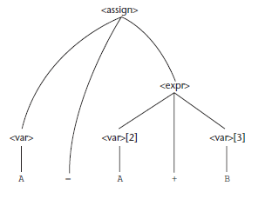
Parse Tree

Slide 6
Attribute Grammar
To describe more of the structure of a programming language that can be described with a context-free grammar.
It is an extension to a context-free grammar.
The extension allows certain language rules to be conveniently described, such as compatibility.

Slide 7
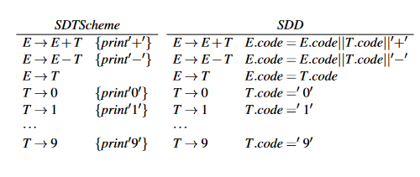
Infix to Postfix
http://www.cse.iitm.ac.in/~krishna/cs3300/lecture4.pdf

Slide 8
Not possible
All variables must be declared before they are referenced.

Slide 9
Static Semantics
Some characteristics of the structure of the programming languages that are difficult to describe and some impossible.
For example, in Java. Assigning float to integer variable is not possible but reverse is legal.
This can be done with BNF, however it needs additional terminals and rules. In such case, the grammar of a language will be too large.
The size of the grammar determines the size of syntax analyser.

Slide 10
Static Semantic Rules
Indirectly related to the meaning of programs during execution; rather it has to do with the legal forms of programs (syntax rather than semantics).
In many languages it is for the type constraints.
It is named static because to be done at the time compilation.
To describe static semantics with BNF, attribute grammar was designed (Knuth 1968).

Slide 11
Attribute Grammar
For describing and checking the correctness of the static semantic rules of a program.
It is a CFG with an added attributes, attribute computation functions, and predicate functions.
Attributes are associated with the grammar symbols (T and NT), are similar to variables in the sense that they can have values assigned to them.
Attributed computation functions – semantic function associated with the grammar rules.
Predicate functions – state the static semantic rules of the language, are associated with grammar rules.

Slide 12
Features
Synthesized (actual type) and Inherited attributes (expected type).
Semantic functions.
Predicate function – true if associated NT is legal and false is illegal.
Fully attributed and Intrinsic Attributes

Slide 13
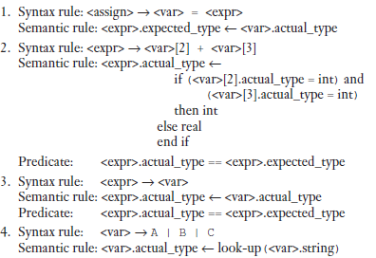
Attribute Grammar

Slide 14
Parse Tree

Slide 15
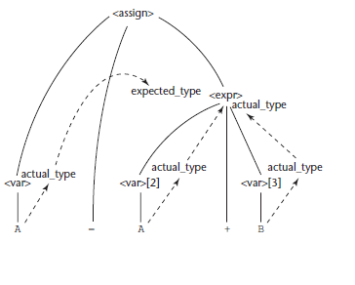
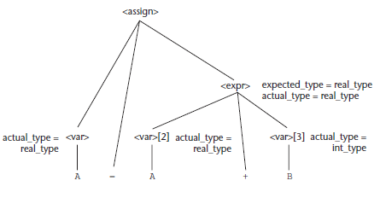
Computing Attribute Values

Slide 16
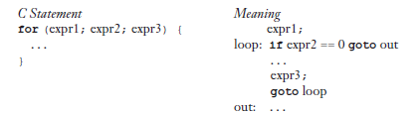
Dynamic Semantics
This is to create an appropriate intermediate language.
Operational semantics – describe the meaning of the statement.
Natural - the interest is in the final result of the execution of a complete program
Structural - operational semantics can be used to determine the precise meaning of a program through an examination of the complete sequence of state changes that occur when the program is executed.

Slide 17
Denotational Semantics
In denotational semantics, we define a language by assigning a mathematical meaning to functions; i.e., we say that each expression denotes a particular mathematical object.
Operational - sourceExpression₁ → sourceExpression₂
Denotational - sourceExpression₁ means → mathematicalEntity₁ = mathematicalEntity₂ means ← sourceExpression₂
It has a domain and range
Domain is the collection of values that are legitimate parameters to the function.
The range is the collection of objects to which the parameters are mapped.
Syntactic domain - domain
Semantic domain - range

Slide 18
Difference
In operational semantics - programming language constructs are translated into simpler programming language constructs, which becomes the basis of the meaning of the construct. Step by step processing of programs
In denotational semantics – programming language constructs are mapped to mathematical objects, either sets, or more often, functions. No step by step processing of programs.

Slide 19


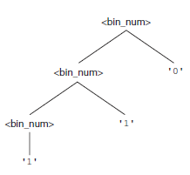
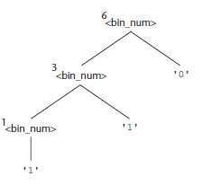
Example
The semantic function, named Mbin, maps the syntactic objects, as described in the previous grammar rules, to the objects in N, the set of non-negative decimal numbers.

Slide 20
Axiomatic Semantics
Specifies, what can be proven about the program.
Here, it is more about the relationship of the variables and constants.
Applications
Program Verification
Program Semantics Specification

Slide 21
Assertions
Constraints on the program variables at that point in the program.
Pre and Post Condition
sum = 2 * x + 1 {sum > 1}
Weakest Pre-condition
Inference Rule – top->antecedent and bottom -> consequent
S1,S2,S3…Sn
----------------
S
An axiom is a logical statement that is assumed to be true. Therefore, an
axiom is an inference rule without an antecedent.

Slide 22

Assignment Statement
Let x = E be a general assignment statement and Q be its postcondition. Then, its weakest precondition, P, is defined by the axiom
P = Q_{x→E}
which means that P is computed as Q with all instances of x replaced by E.
For example, if we have the assignment statement and postcondition
a = b / 2 - 1 {a < 10}
the weakest precondition is computed by substituting b / 2 - 1 for a in the postcondition {a < 10}, as follows:
b / 2 - 1 < 10
b < 22
{P} S {Q}
rule of consequence =
Try this : x = x + y - 3 {x > 10}
y > 13 - x

Slide 23

Sequences of statement
y = 3 * x + 1; x = y + 3; {x < 10}
{x < 2}
Selection
Logical Pretest Loops - predicate transformer (one predicate is used for another predicate)

Slide 24

Program Proofs

Slide 25
Variables
Attributes: (name, address, value, type, lifetime, and scope).
Names
Are names case sensitive?
Are the special words of the language reserved words or keywords?
The address of a variable is sometimes called its l- value, because the address is what is required when the name of a variable appears in the left side of an assignment.
The type of a variable determines the range of values the variable can store and the set of operations that are defined for values of the type.
A variable’s value is sometimes called its r- value because it is what is required when the name of the variable appears in the right side of an assignment statement. To access the r- value, the l- value must be determined first.

Slide 26
Binding
A binding is an association between an attribute and an entity, such as between a variable and its type or value, or between an operation and a symbol.
The time at which a binding takes place is called binding time.
For example, the asterisk sym bol (*) is usually bound to the multiplication operation at language design time.
At compile time, a variable in a Java program is bound to a particular data type

Slide 27
Type Binding
Static Type Binding: explicit and implicit declaration -> default or inference
Dynamic Type Binding – This is at the runtime.

Slide 28
Storage Bindings and Lifetime
The memory cell to which a variable is bound somehow must be taken from a pool of available memory. -> Allocation an Deallocation.
Lifetime of a variable -> the time during which the variable is bound to a specific memory location.
Static Variables - Bound to memory cells before program execution begins and remain bound to those same memory cells until pro gram execution terminates. [Global declaration and static keyword]
Stack-Dynamic Variables

Slide 29
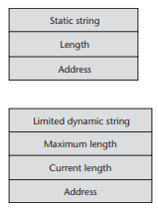
Data Types
Primitive Data Types
String
Should strings be a special kind of character array or a primitive type?
Should strings have static or dynamic length?
Arrays – Static, Fixed Stack-Dynamic, Fixed Heap-Dynamic, Heap-Dynamic.
Rectangular and Jagged Arrays

Slide 30
Pointer – Design Issues
What are the scope and lifetime of a pointer variable?
What is the lifetime of a heap- dynamic variable (the value a pointer references)?
Are pointers restricted as to the type of value to which they can point?
Are pointers used for dynamic storage management, indirect addressing, or both?
Should the language support pointer types, reference types, or both

Slide 31
Operations
Assignment
Dereferencing.
Dangling Pointers: A dangling pointer, or dangling reference, is a pointer that contains the address of a heap-dynamic variable that has been deallocated.
memory leakage

Slide 32
Reference Type
A reference type variable is similar to a pointer, with one important and fundamental difference:
A pointer refers to an address in memory, while a reference refers to an object or a value in memory.
int result = 0;
int &ref_result = result;

Slide 33
Expressions
An operator can be unary, meaning it has a single operand, binary, meaning it has two operands, or ternary, meaning it has three operands.
Operator Evaluation Order – Precedence, Associativity, Parenthesis
Operand Evaluation Order
Side effect: A side effect of a function, naturally called a functional side effect, occurs when the function changes either one of its parameters or a global variable.
a + fun(a)
int a = 5;
int fun1() {
a = 17;
return 3;
} /* end of fun1 */
void main() {
a = a + fun1();
} /* end of main */

Slide 34
Referential Transparency and Side Effects
A program has the property of referential transparency if any two expressions in the program that have the same value can be substituted for one another anywhere in the program, without affecting the action of the program.
result1 = (fun(a) + b) / (fun(a) - c);
temp = fun(a);
result2 = (temp + b) / (temp - c);
If the function fun has no side effects, result1 and result2 will be equal, because the expressions assigned to them are equivalent. However, suppose fun has the side effect of adding 1 to either b or c. Then result1 would not be equal to result2. So, that side effect violates the referential transparency of the program in which the code appears.

Slide 35
Assignment Statements
Simple Assignments
Conditional Targets
Compound Assignment: sum += value;
Unary Assignment: sum = ++ count;
Assignment as an Expression
Multiple Assignments

